Slide 1

Transferring money to Merchant
Product Teardown
Mayank Kumar

Slide 2
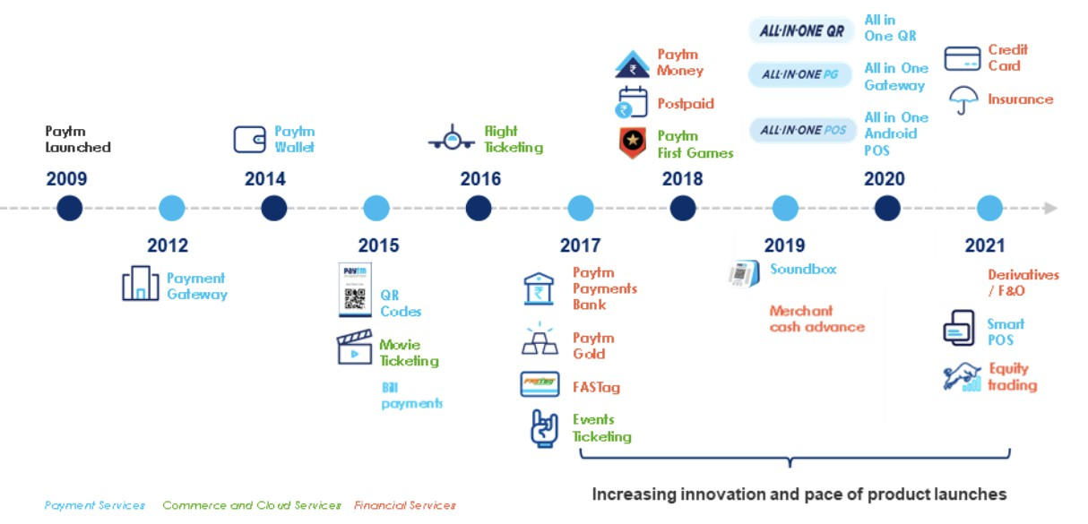



Paytm (acronym for "pay through mobile") is an Indian digital payments and financial services company, based in Noida founded in 2010.
For Fiscal year 2021-22, Paytm's GMV value was
$110 billion.
The company’s primary use case is
mobile payment services to consumers and merchants - through QR, POS, payment gateway offerings.
In addition to this, the company also offers financial services through partnership with financial institutions.
Apart from bill payments and money transfer, Paytm also deals with ticket booking, retail brokerage, & games
It has industry-best transaction success rates with an uptime of 99.99%
Competitors:
Value Propositions: Recharging Business E-commerce
Paytm Wallet Digital Gold
User Persona
User Journey
User Experience Insights

Slide 3


Ramesh
40, Store Owner New Delhi, India
Suresh
26, Working Professional Gurgaon, India
Behaviour:
Prefers traditional cash methods but has to adapt to age of digital payments. Wants to keep track of the payments. Wants a simple payment interface.
Pain Points:
Doesn’t want to loose customers who prefer digital payments. Isn't tech savvy so needs a simple to understand UI.
Sometimes doesn’t have exact change while a customer pays with cash.
High transaction/convenience fee of cards.
Behaviour:
Being a netizen, he finds it intuitive to make
transactions cash free online. Frequent online orders, seeks cash free options in physical
stores as well.
Pain Points:
Some offline stores aren’t familiar with cash free systems, hates that as he is forced to carry cash.
Doesn’t prefer to carry wallet (for cash and cards) as it may get stolen.
Finds his bank’s app inconvenient to check
balances and too ‘bulky’ for transactions.
User Persona
User Journey
User Experience Insights

Slide 4
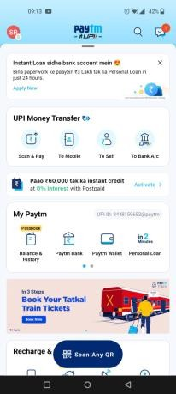
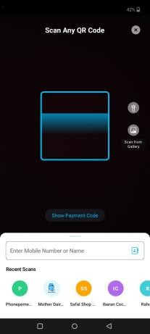
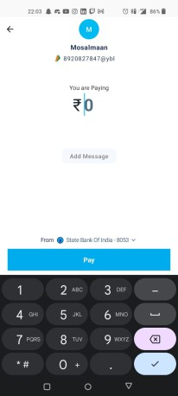
Home Page
Scan QR
Enter Amount
Doing
Wow there are a lot of icons.
Good thing they just have a
separate ‘scan QR’ button for
quick navigation.
This is good, we can even give a scan from gallery and access recents below. Can even enter ph. no if scan not working/available. This is simple & clean.
This is simple enough. I really wish all payment gateways were like this. I can also select between multiple payment options, nice!
Thinking
😥
☺️
☺️
Feeling
Too many icons. Need a simple home page with options we actually need on day to day basis. Rest can be organised in dropdowns.
For a non-netizen, a simple dropdown beside the account detail isn’t intuitive enough to select another account.
Should have more clarity, separate button
Pain Points & Solutions
User Persona
User Journey
User Experience Insights

Slide 5
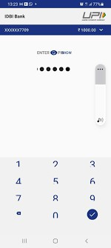
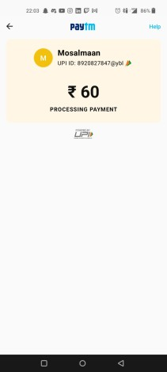
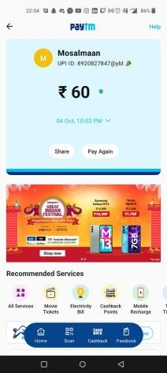
Enter PIN
Processing
Confirmation
Doing
I really hope this doesn’t take much time. Is my internet alright?
Yay! That was fast! Now I can enjoy my favourite Pizza!
Thinking
I hope no one is looking.
😥
😕
🤩
Feeling
The numbers in keypads should be shuffled to avoid PIN leaks.
Can also add other security options like fingerprint.
Screenshot prevention.
In low internet speed areas, we might introduce a timer to show that the server is responding & request is being processed but due to low speeds its taking time to reflect.
It is not intuitive to click scan button below to make another payment with different vendor. Should have more clarity.
Pain Points &
Solutions
User Persona
User Journey
User Experience Insights

Slide 6
The Pros
Clear to see “scan QR” button. Makes it simple for quick transactions.
Scan, phone number & other options present at the centre of home page
right where the user’s vision goes first typically.
Allows me to check my account balance conveniently.
Helps keep track of payments.
The Cons
Ads in the home screen are distracting elements of the UI.
To provide ease of access to its vast number of products, the UI gives a crowded impression. Need to make it more sleek.
Needs high speed connection. Might affect tier 3 city market penetration.
Can’t send bills to customers conveniently.
User Persona
User Journey
User Experience Insights

Slide 7
North Star Metric: Payment success rate
Total # Trxn completed.
Total #transactions completed / Total Taps on
payment initiator buttons.
Here, payment initiator button is “scan QR”, “To mobile”, “To Bank A/C” etc.
#Merchant renewing contract / repeat or resurrected merchants.
#Trxn completed per customer.
DAU / MAU of Paytm (“stickiness of app”)
Merchant payment volume
# Trxn completed per merchant
Av. Merchant Onboarding Time & Av. Customer Onboarding Time
Cost of customer acquisition = cost of sales & marketing / #Cx acquired.
Customer lifetime value
User Persona
User Journey
User Experience Insights

